Slide 1
بسم هللا الرحمن الرحيم

Slide 2

SOFTWARE DEVELOPMENT FINAL PROJECT BY Group 7
Course Name : Software Development 2
Course Code: CSE-3640
Course Teacher: Atia Binti Aziz
Adjunct faculty , Dept. Of CSE,IIUC

Slide 3
SOFTWARE DEVELOPMENT FINAL PROJECT BY Group 7
PROJECT NAME: Diamond Hotel Booking
TEAM NAME: Group-7
Section:6AF
Semester:6th
TEAM MEMBERS:
C193209_Sahana Akter
C193214_ Samira Saimee
C193221_Lubna Sultana

Slide 4



Tools:
Intelli J IDEA.
Java OOP
Data Storing in File

Slide 5
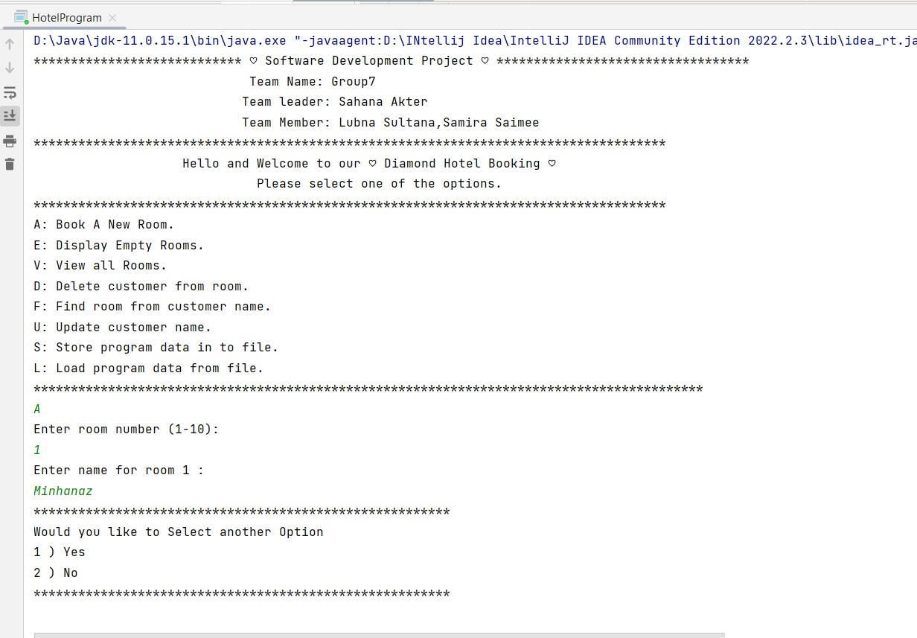
Welcome to our project 1) Book A New Room!

Slide 6
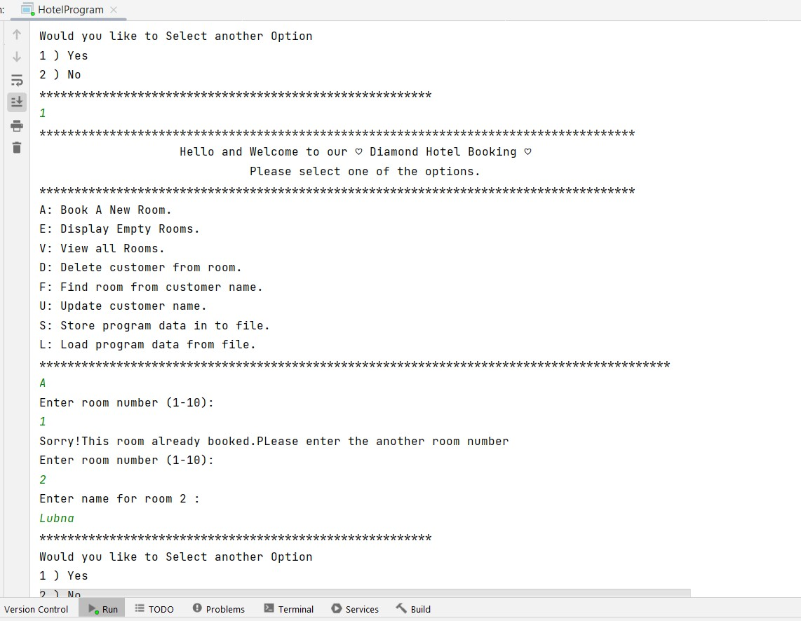
If same room book then it will message sent this -> already room booked.
This message show

Slide 7
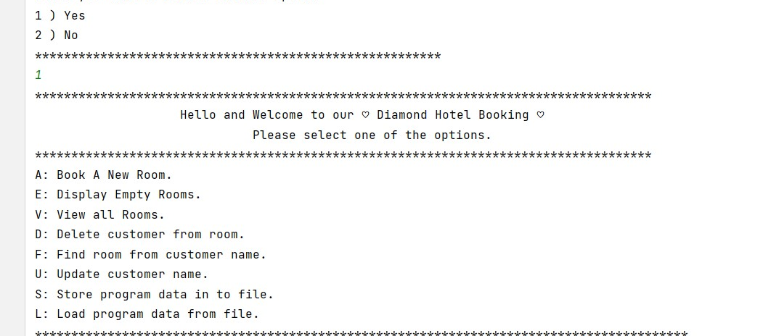
If we are continue

Slide 8
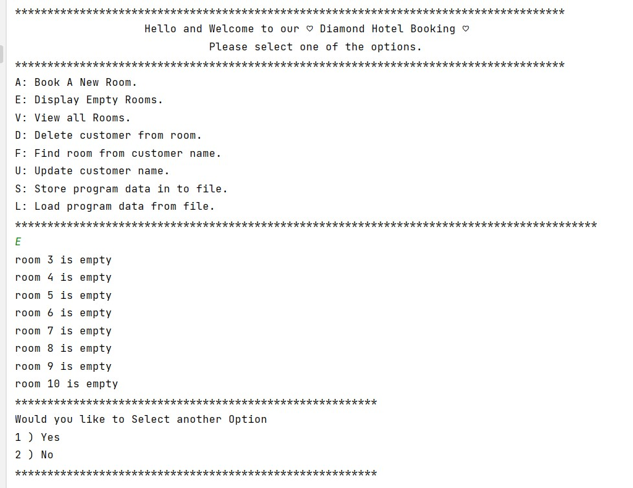
2) Display Empty Rooms.
This empty room show

Slide 9
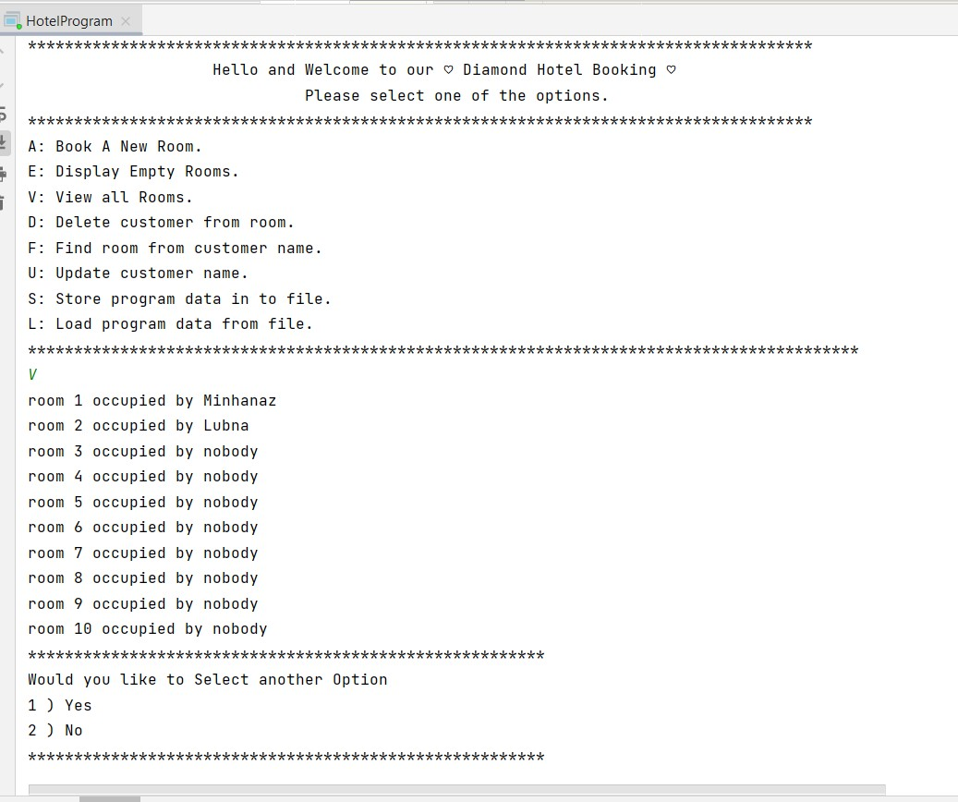
3) View all Rooms.
This all room show

Slide 10
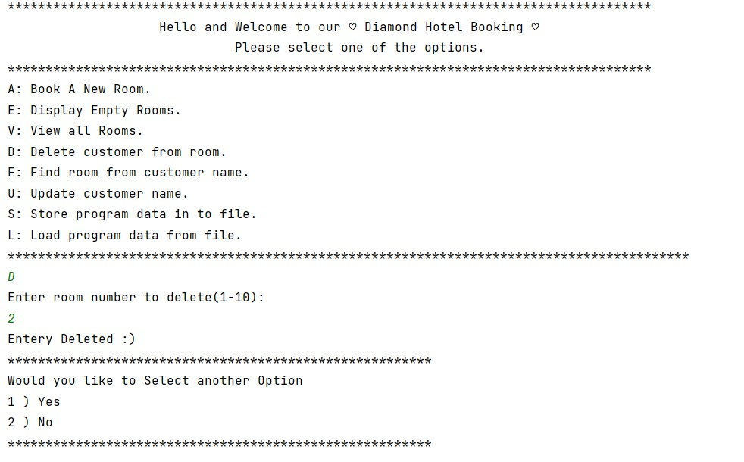
4) Delete customer from room.

Slide 11
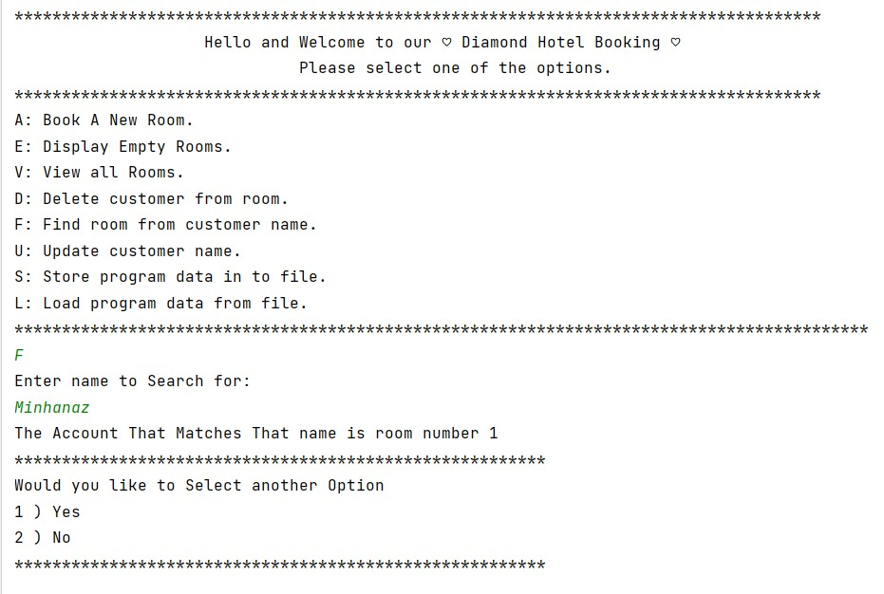
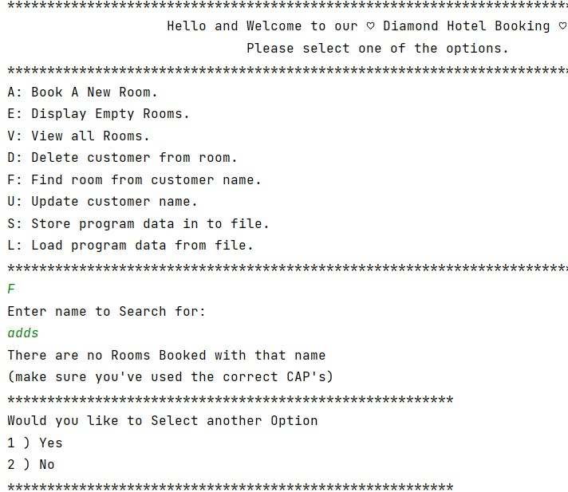
5) Find room from customer name.

Slide 12
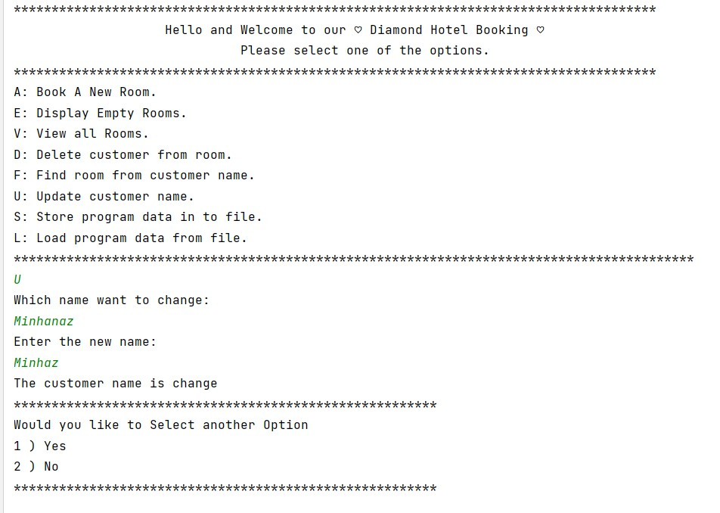
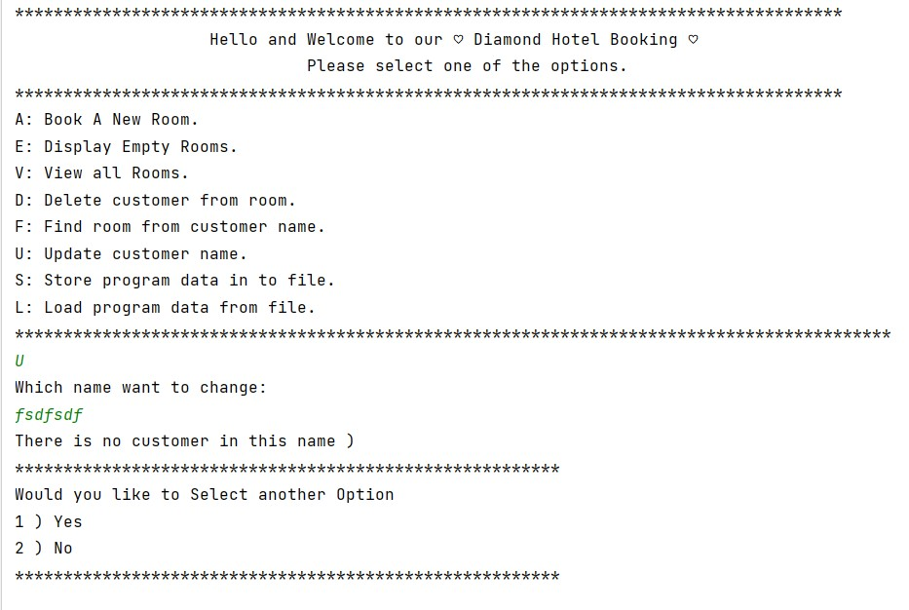
6) Update customer name.

Slide 13
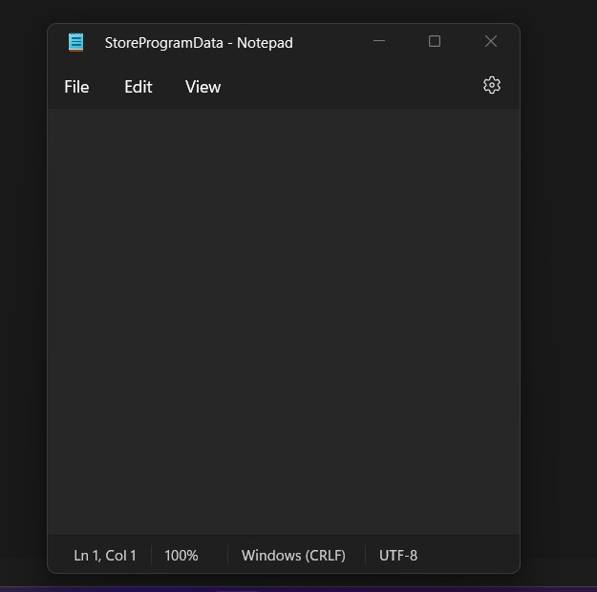
7) Store program data in to file.
If we want all information save in a file.
1st we create a empty file
File is empty

Slide 14
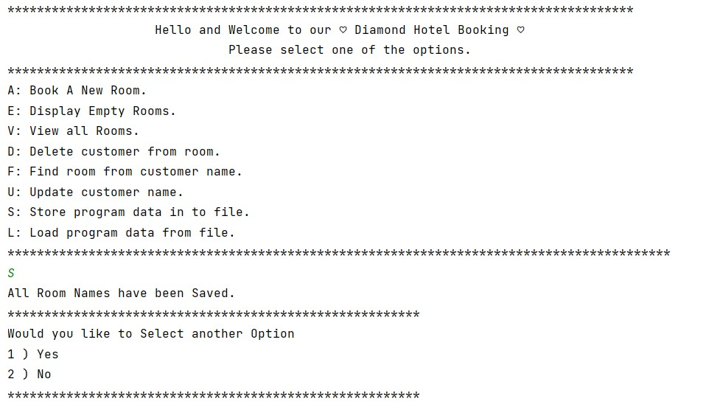
Then we save all the information

Slide 15
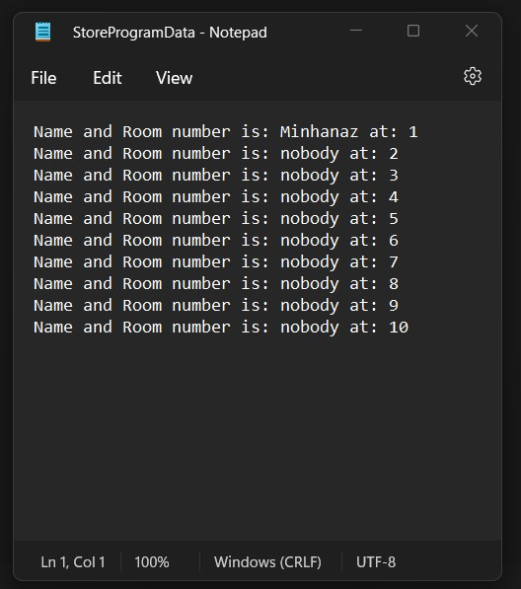
Then we see all the information save on a File.

Slide 16
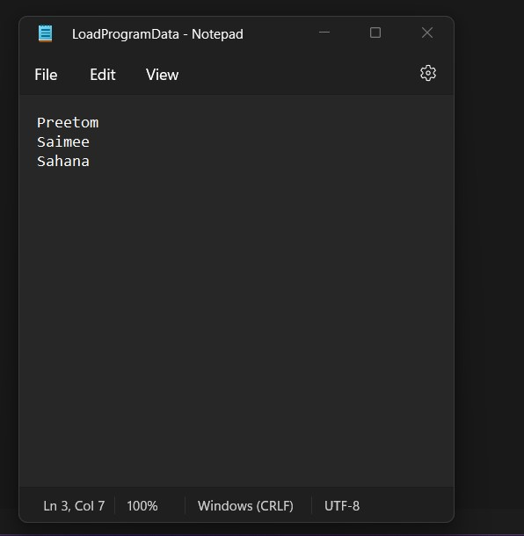
8) Load program data from file.
If we want input from the file.
1st we create a empty file.
Then give some input.

Slide 17
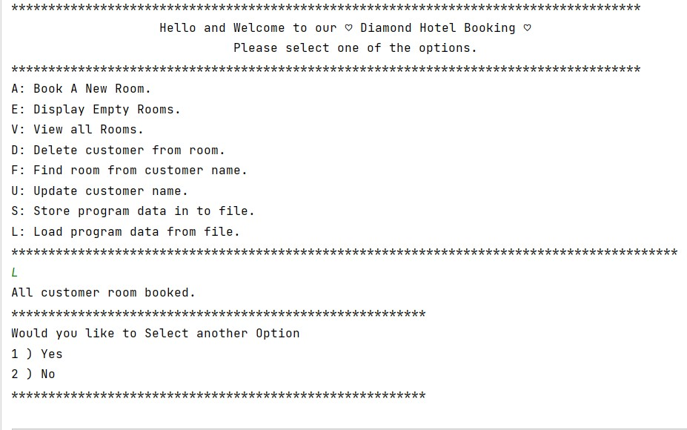
Then we input the data from the file

Slide 18
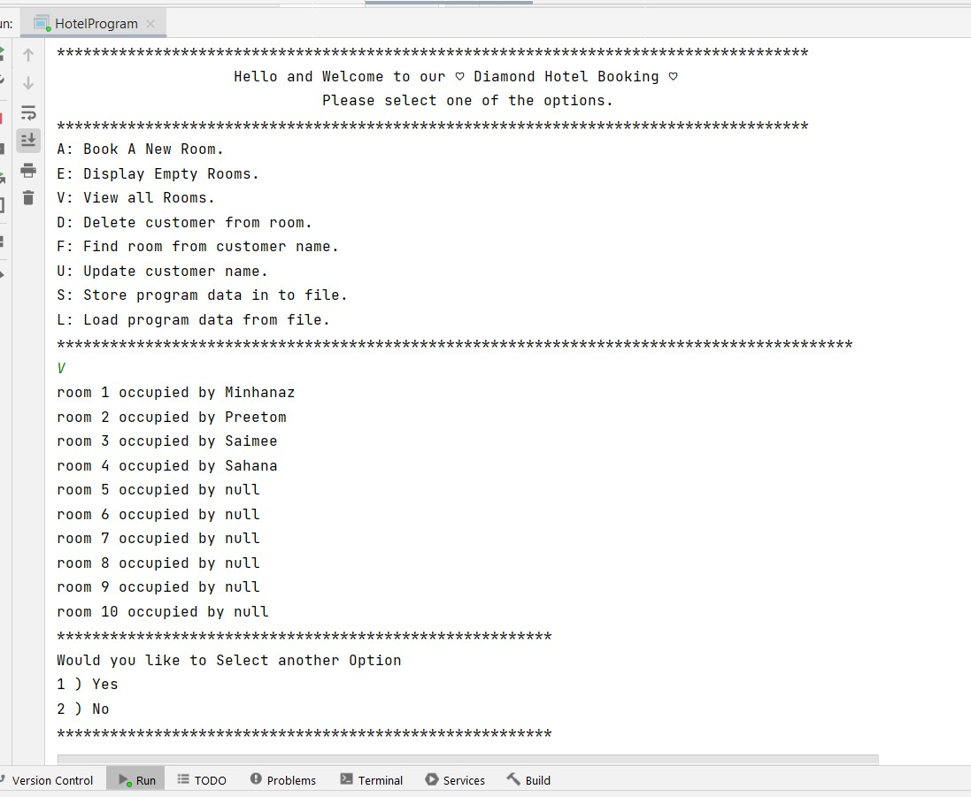
Now we can see that view rooms.

Slide 19
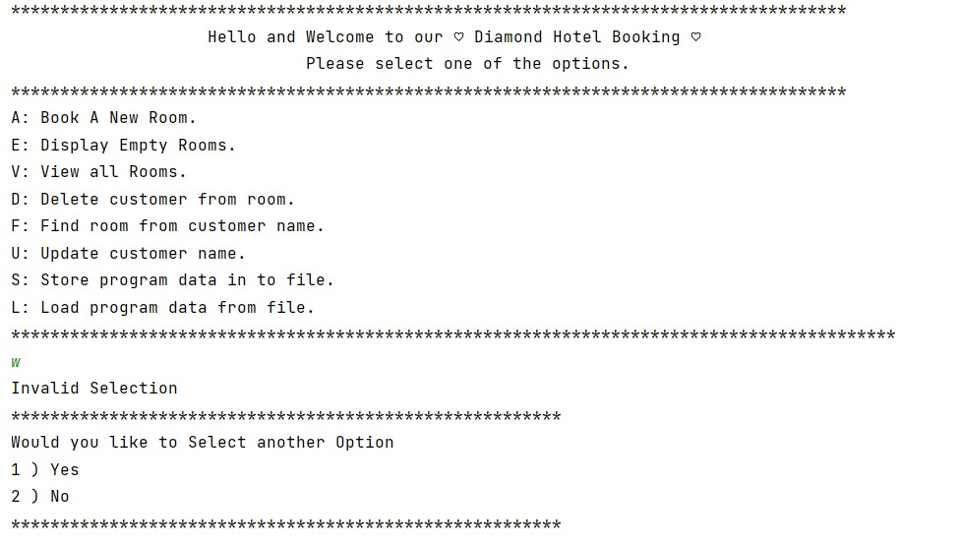
9)If we choice another invalid option.

Slide 20
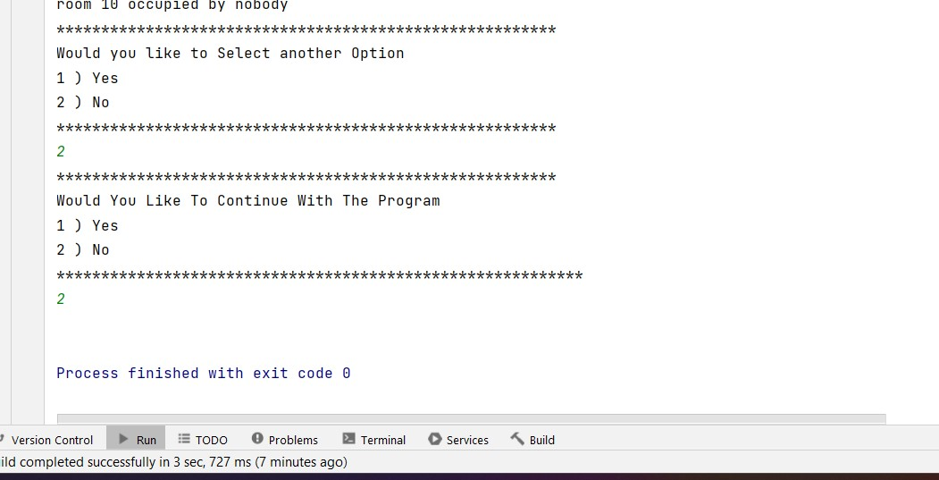
Option select

Slide 21
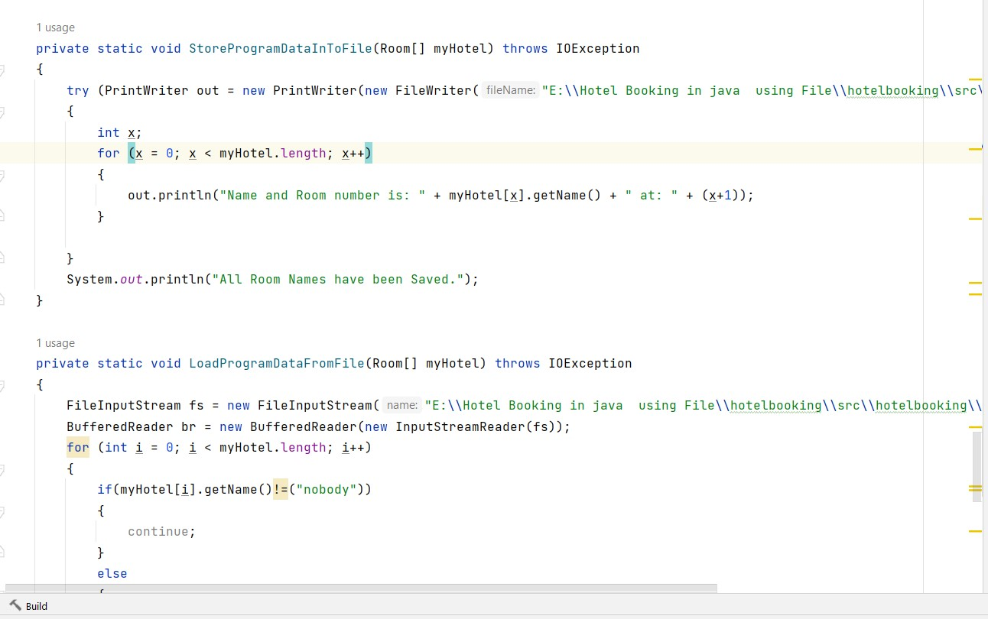
Error Handling
We use error handling in this here->

Slide 22
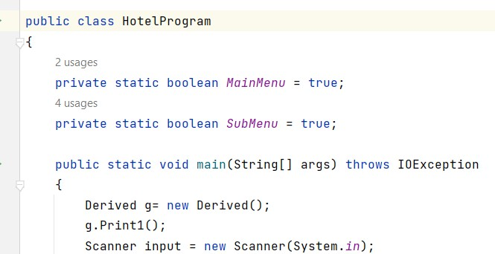
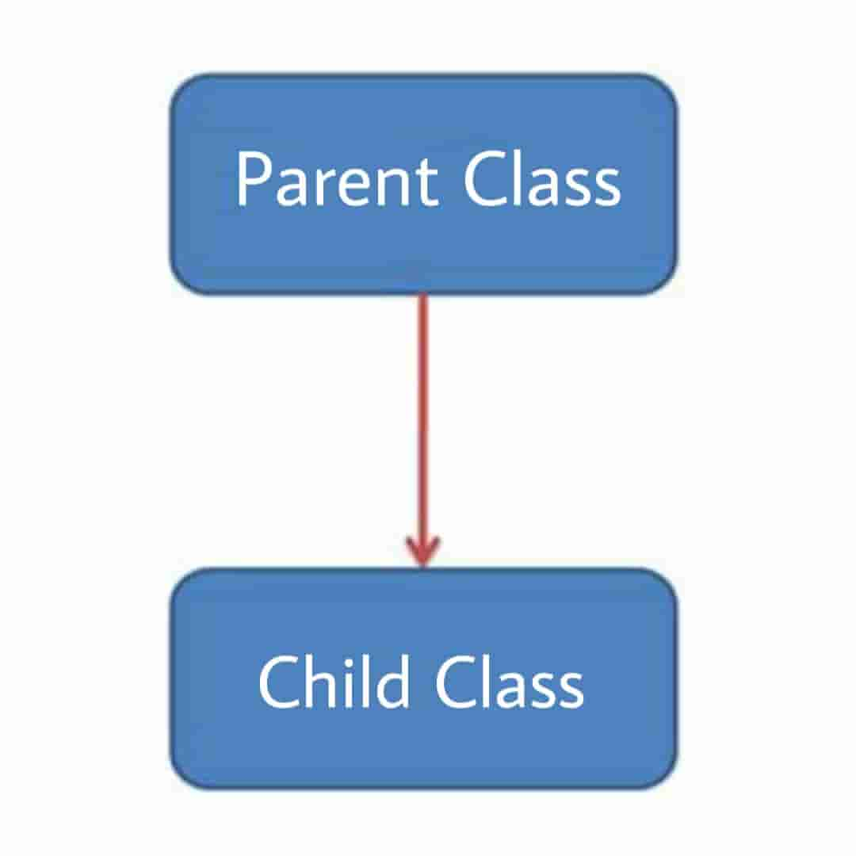
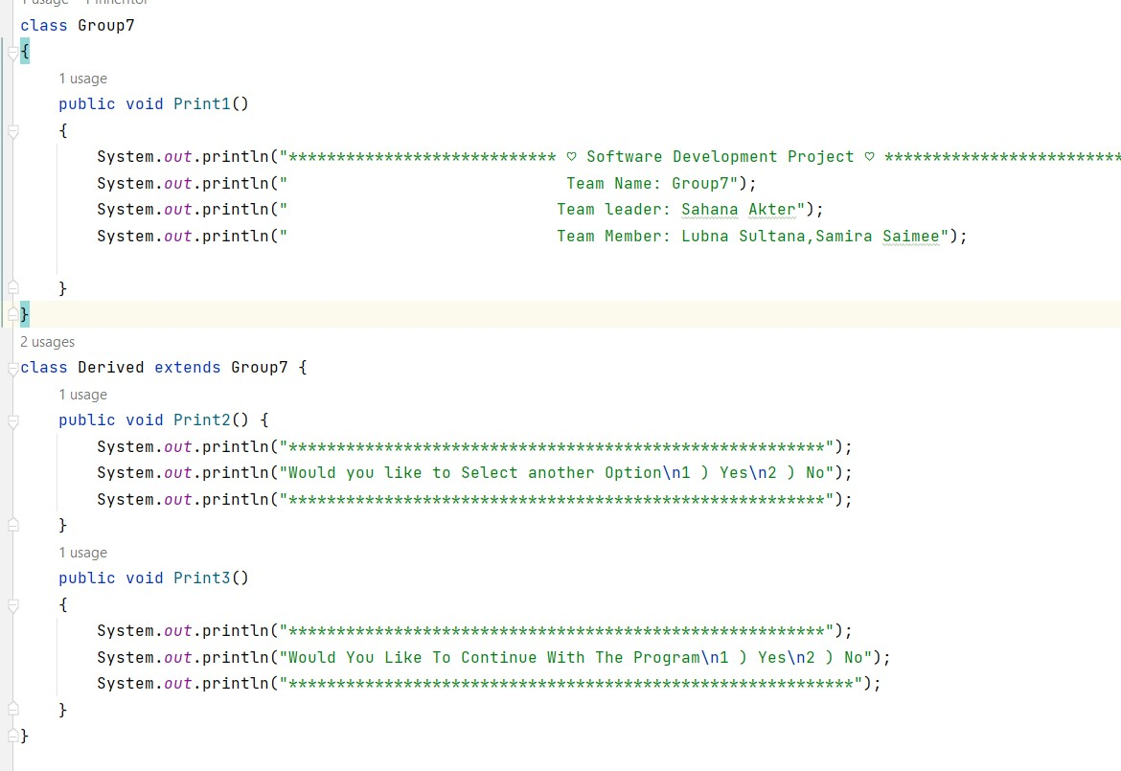
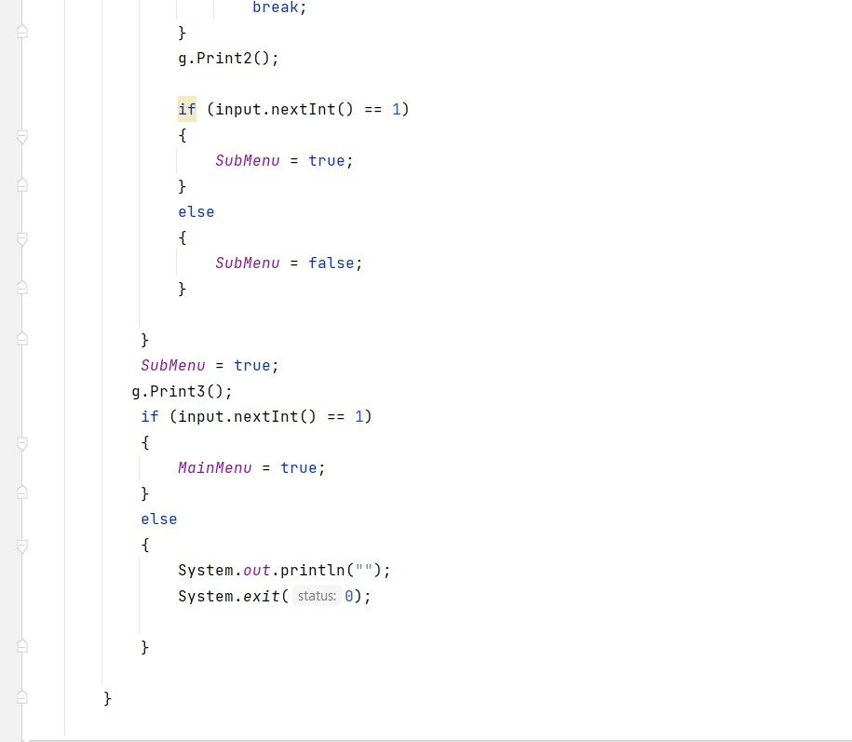
OOP Implementation
We use here Inheritance ->

Slide 23
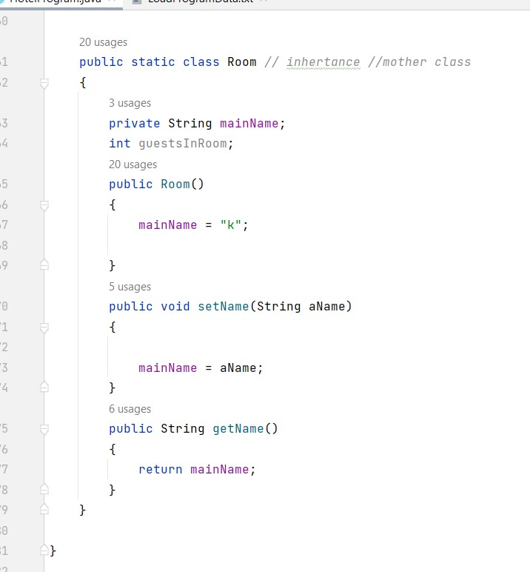
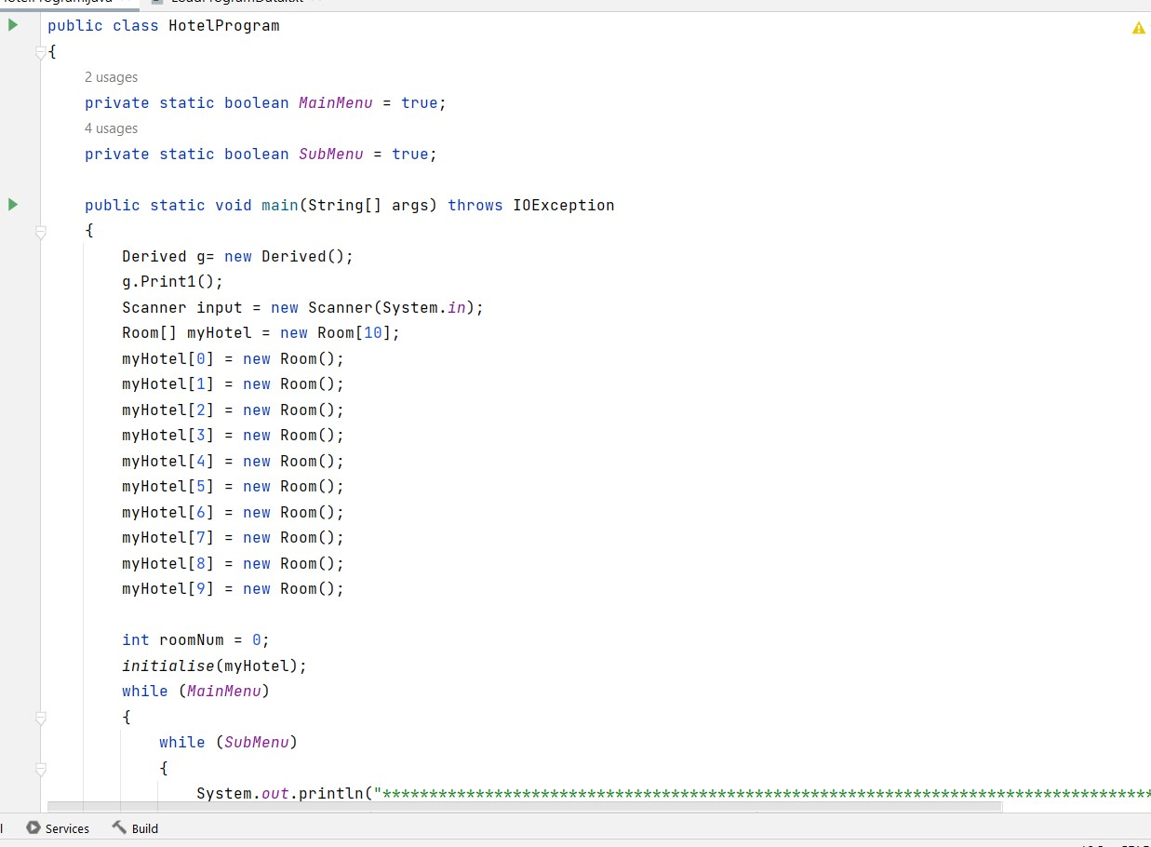
We use another Inheritance ->

Slide 24
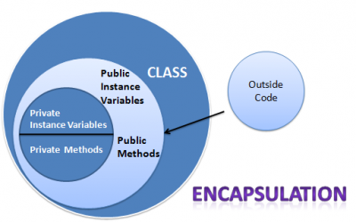
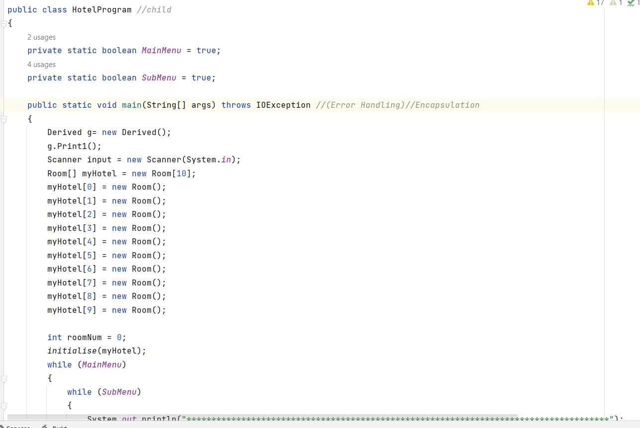
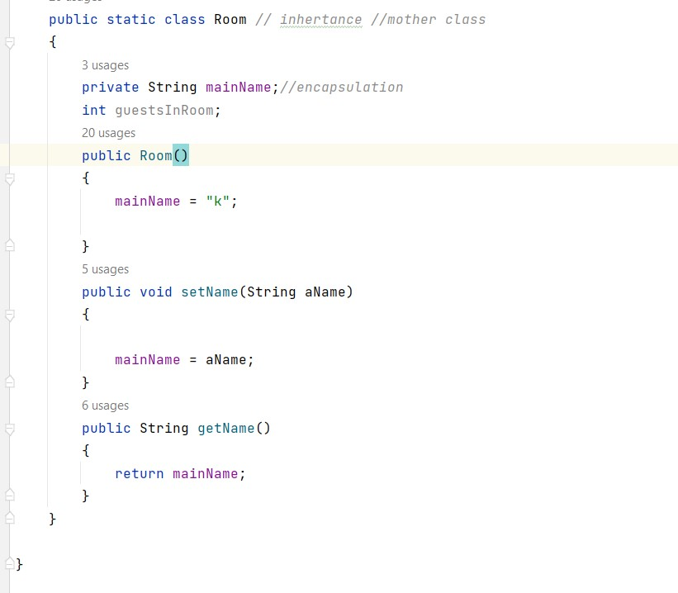
We use here Encapsulation ->

Slide 25
Limitation
We can’t add customer more information.
We have no employee information
Future Plan
To convert this project in app then we can use it by laptop , desktop and mobile Add restaurant option in our project.
Add also driver.
Add review option for the customer.

Slide 26
Github link
Sahana->
https://github.com/Sahana-Akter/Hotel-Booking-in-java-using-File.git
Saimee->
mms
Lubna->
dss

Slide 27
THANK YOU
HOPE YOU LIKED OUR PROJECT

